Slide 1

ICD PROJECT
Members:
Josue Cobos Salvador
Enmanuel Magallanes Pinargote

Slide 2
Main dataset descripcion
The dataset used contains information on Shippify deliveries on Santiago of Chile. The available information is as follows:
ID of delivery: unique identifier.
Route ID of delivery: unique identifier of a route (contains more of tow deliveries).
Creation date: timestamp of creation delivery.
Delivery type: could be Flex or Slot.
Slot: are tasks that have a collection date, of the package(s), with a maximum time window of one hour from the specified time.
Flex: are those tasks that have a collection interval of more than one hour, maximum 12 hours.
Cost: money paid to the shipper.
Total size: size of delivery.
Distance: distance from pickup location to drop off location.
Pickup and drop off location: latitude and longitude for pickup and drop off.
Notes:
Describo el data set

Slide 3
Traffict dataset descripcion
This dataset was obtained from TOMTOM that service to fetch information about traffic of cities. The dataset used contains information about of traffic on Santiago de Chile. The available information is as follows:
ID of segment: unique identifier.
Polygon: area of Santiago of chile.
Traffict segments: list of object (JSON) with this structure:
Time slide: slide of 3 hours of the day
Traffict: intensity of traffict from 0 to 1
Notes:
Describo el data set

Slide 4
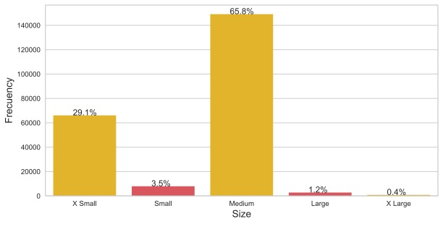
Size of deliveries
Notes:
Mayor porcentaje de tareas Medium y X Small

Slide 5
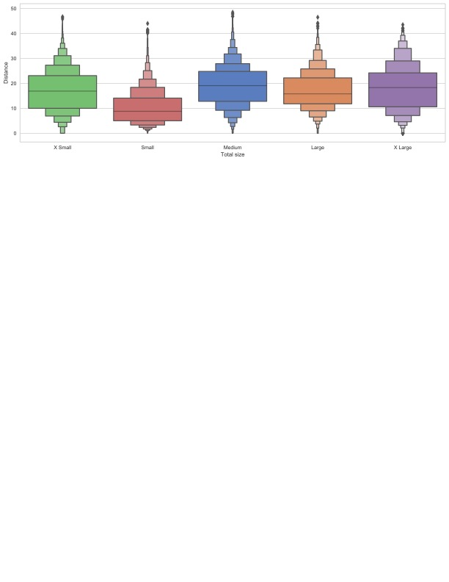
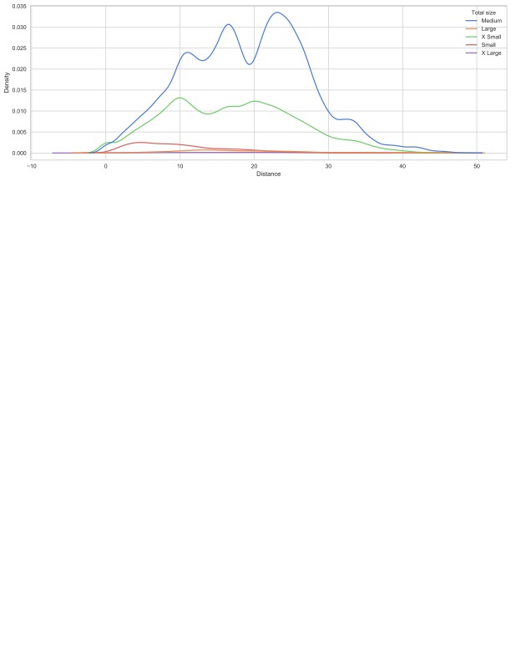
Size of deliveries
Notes:
Las distnacias de tareas por su tipo de tamaño, Small mas cortas y Medium mas largas, el resto muy similar

Slide 6
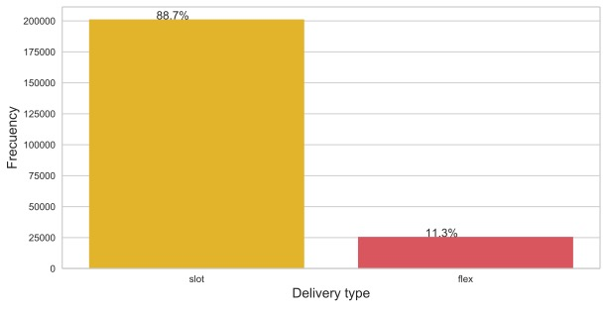
Delivery type

Slide 7
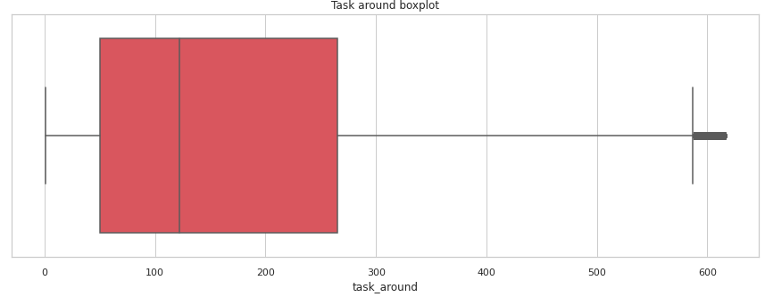
Task around (Neighboring deliveries)
We define neighboring deliveries as all those deliveries that are less than or equal to X Km away from the same and their delivery date is within T hours of the same.

Slide 8
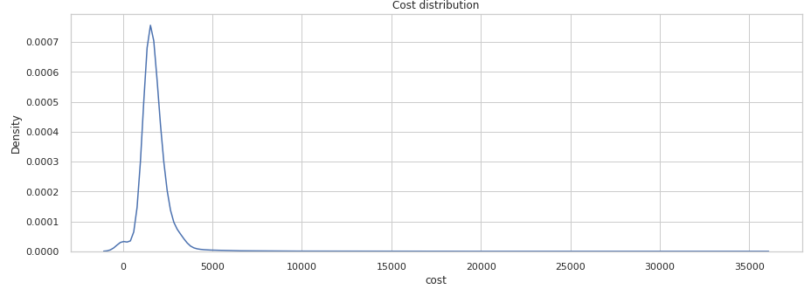
Cost

Slide 9
Delivery type
Notes:
En este FaceGrid ponemos obsrvar como es la relacion del cost vs la distancia segun el tipo de tarea y su tamaño, X Small y Small son las que presentan una correlacion debil positiva.

Slide 10
Correltion Distance vs Cost
Delivery size | Delivry type | Correlation
X Small | Flex | 0.60778
Small | Flex | 0.66596
Large | Flex | 0.52945
Notes:
Aqui la podemos ver de manera cuantitativa

Slide 11
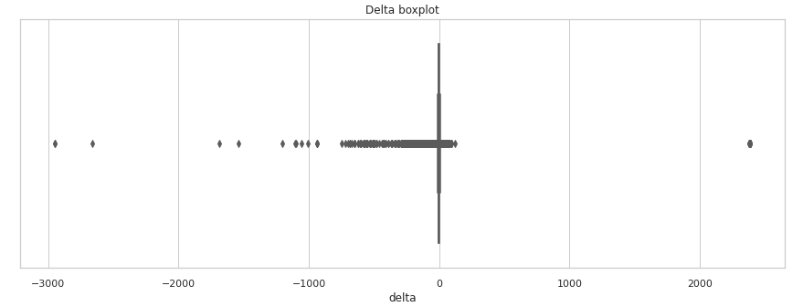
Delay
We define delay like the subtraction of delivery date minus delivery effective date, this first is the date specified in the system to send the shipment and the delivery effective is the date when the shipper made the shipment.
Notes:
Explicar que significa NEGATIVO y POSITIVO

Slide 12
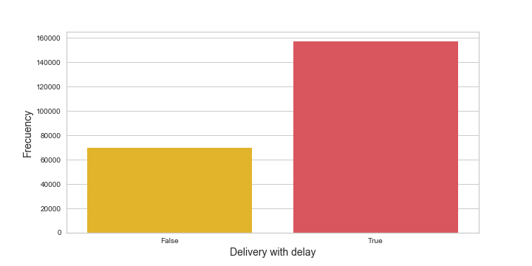
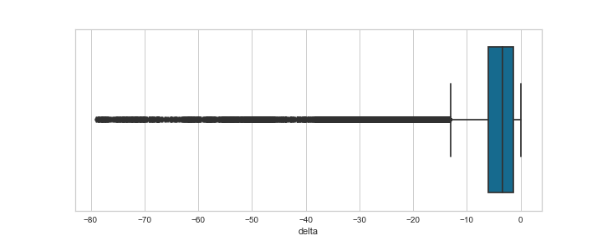
Delay
Notes:
Explicar que significa NEGATIVO y POSITIVO

Slide 13
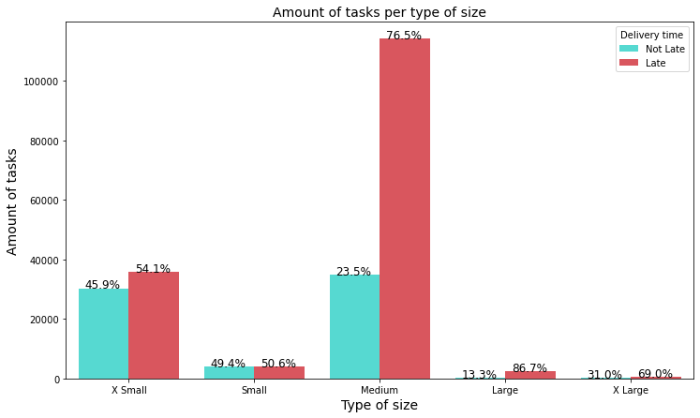
Is the total weight of packages a factor affecting the timeliness of deliveries?
Notes:
El peso de las tareas es un factor que afecta a su tiempo de entrega? Aqui lo importante no es ver tanto la cantidad de tareas por el peso, si no, la diferneccia de porcentaje de tareas atrasadas y no atrasadas. Como podemos observar la diferecnia entre el pocertange de tareas no atrasada y las atrasadas aumenta conforme aumenta el peos de la tarea.

Slide 14
Are tasks with fewer neighboring deliveries* taking longer to reach their delivery point?
To carry out this analysis we first have to determine what would be the time window (hours) and radius (kilometers) around a task to be used. For this we analyzed the distance and average time difference of a route in the delivery path, from the first package to the last one. The following results were obtained:
Mean time: 3.12 hours
Mean distance: 3.20 Km.
* We define neighboring deliveries as all those deliveries that are less than or equal to X Km away from the same and their delivery date is within T hours of the same.
Notes:
Son las tareas con menos cantidad de entregas vecinas aquellas que llegan con mas atrassos? Definimos a una entrega como entrega vecina cuando esta tien una fehca de entrega que esta dentro de una ventdad de tiempo repsecto a una tarea pivote y tambien su ubicacion esta dentro de un perimetro con rexpecto a la entrega pivote. Entonces para ellos calculamos el tiempo que se toma desde el primer al ultimo dropoff y tambine calculamos su distancia, para savar la ventana de tiempo y perimetro.

Slide 15
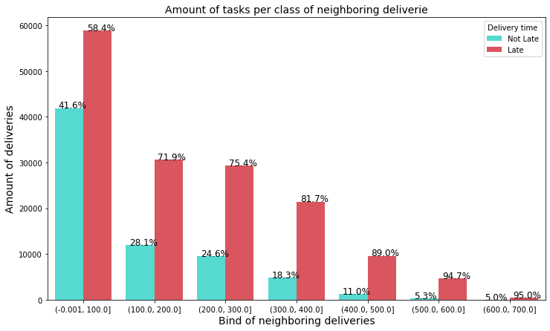
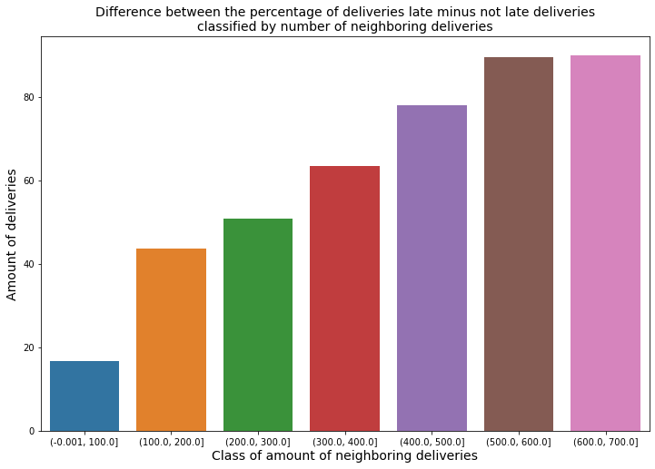
Responding to the question about neighboring deliveries

Slide 16
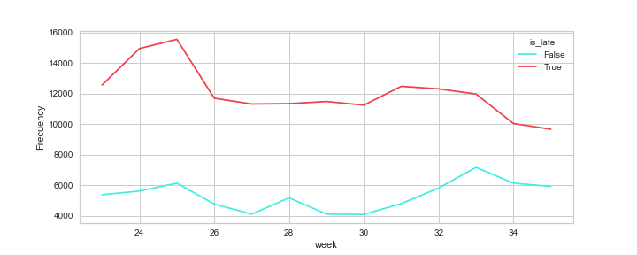
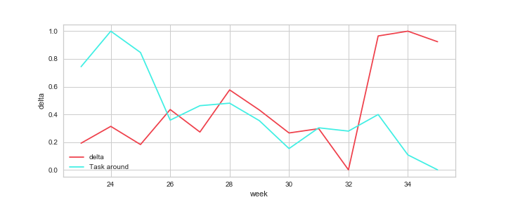
Is there a correlation between the number of neighbors and delivery delays?
Notes:
Podemos observar que el comportamiento del delta tiene a crecer durante el tiempo. mientras que la cantidad de entregas vecinas tiene cierta sensionalidad con una tendencia a decrecer, esta presenta picos en las semanas 24 (8 - 14 Junio), 28 (13 - 19 Julio) y 33 (10 - 16 Agosto) de año 2020. Aparentemente se registran atrasos en tareas principalmente a mitad del mes.

Slide 17
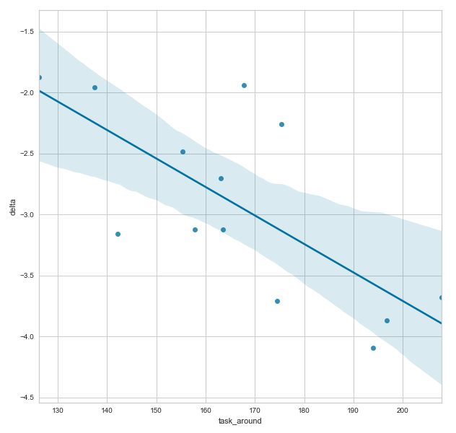
Is there a correlation between the number of neighbors and delivery delays?
 | Delta | Task Around
Delta | 1 | -0.637363
Task Around | -0.637363 | 1

Slide 18
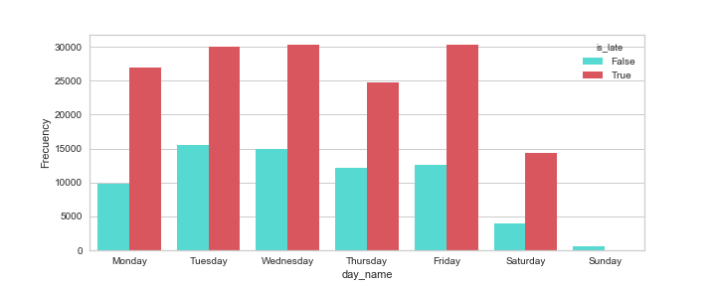
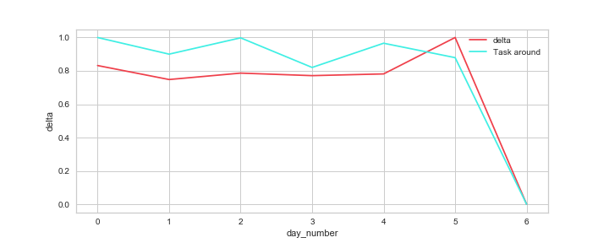
Day week distribution
Notes:
Como se puede observar en las graficas, desde el lunes hasta el sabado se presenta una gran cantidad de entregas con delta, siendo los Lunes, Viernes y Sabados los dias con mayor porcentaje de entregas con delta. Adicionalmente, de Lunes a Sabados el delta de los deliveries es basntante similar, siendo el Sabado el dia que se registra un aumento en los retrasos y el Domingo el dia que se registran menos retrasos.

Slide 19
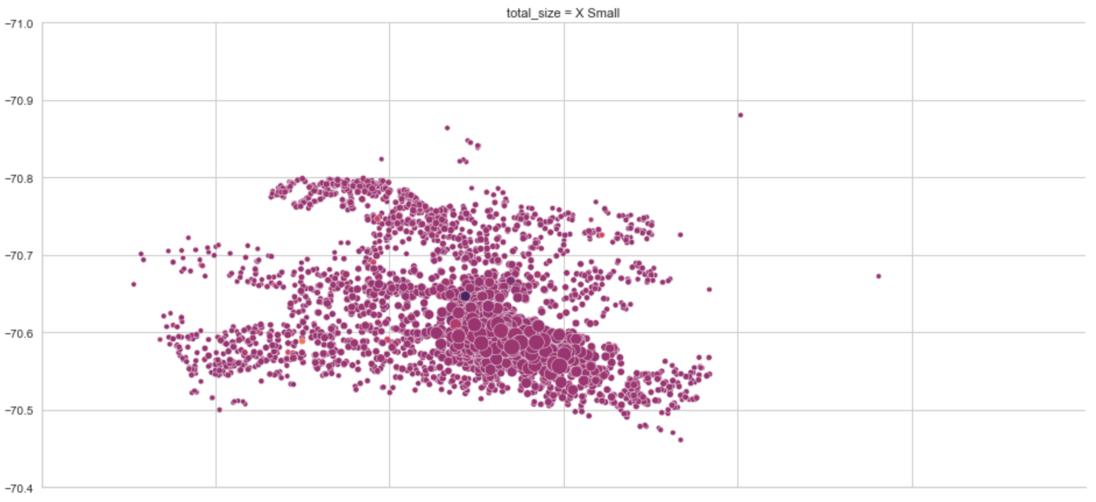
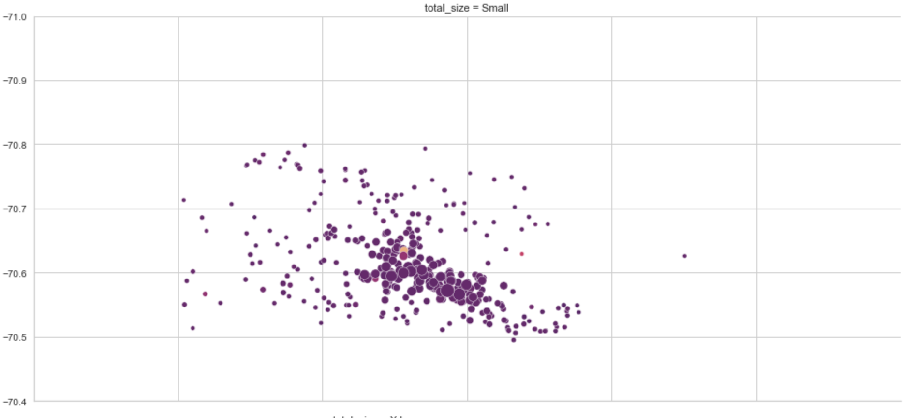
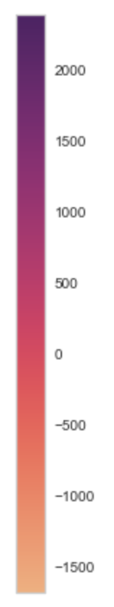
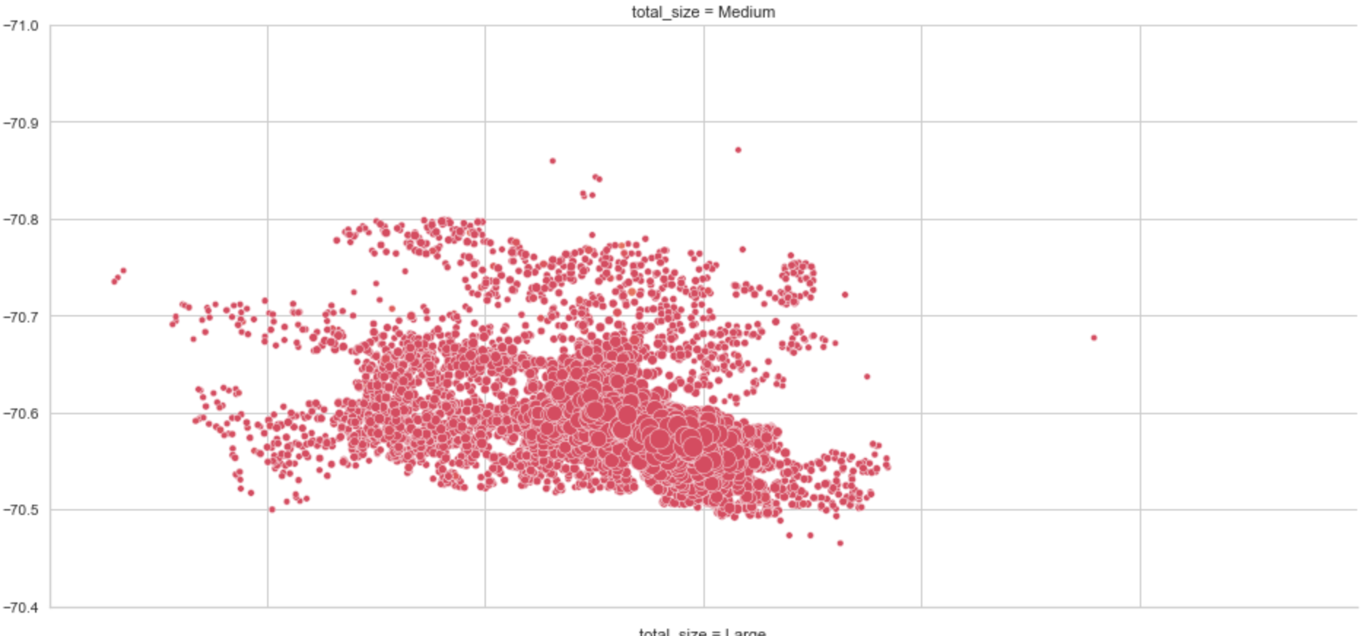
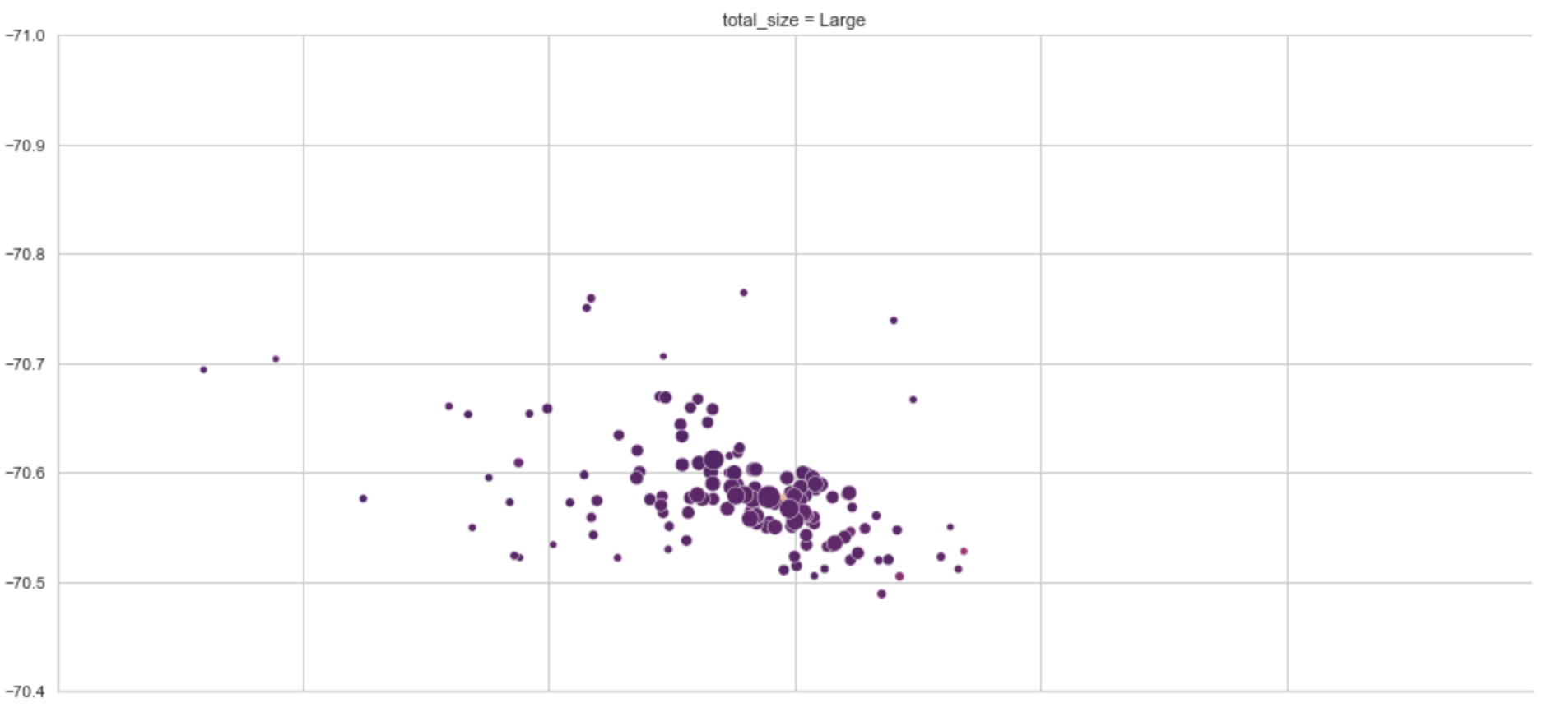
X Small
Small
Size:
Task around
Delta:
Medium
Large
Notes:
Small tiene pocas pero muy atrasadas, X small mas espasidad y menos atrasadas, Medium tiene muchas mas tareas y en general el retraso de sus tareas es muy poco pero igual siguen siendo atrasadas. Larga tiene pocas tareas y muy atrasadas. Ademas podemos ver que en exista un cierta region donde los puntos son mas grandes para todos los plots, esta region correpsonde a una zona residencian de Stg de Chile, ahi se ecnuentra siemrpe una alta concentracion de entregas.

Slide 20
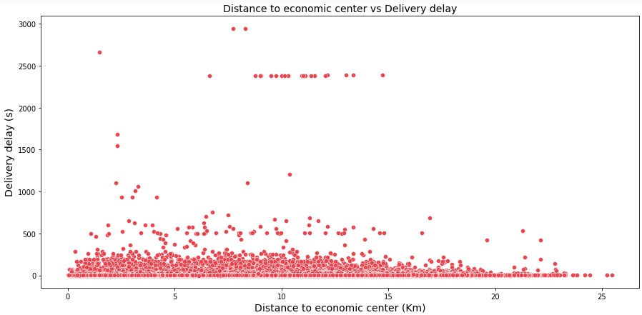
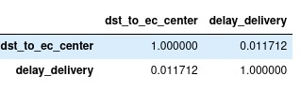
Correlation between delay and distance
Are those deliveries that are further from the economic center of Santiago de Chile those with the longest delivery delay?

Slide 21
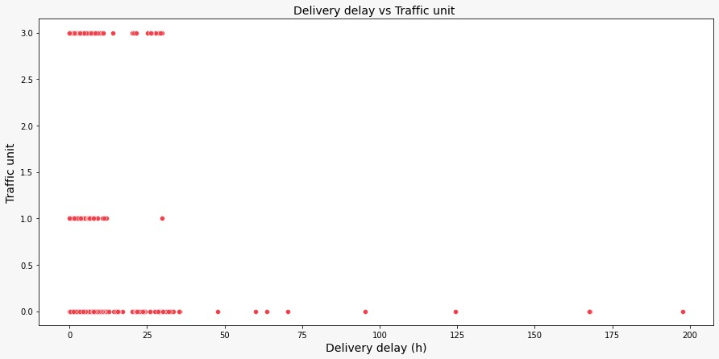
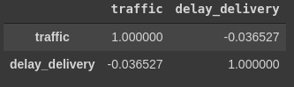
Correlation between delay and distance

Slide 22
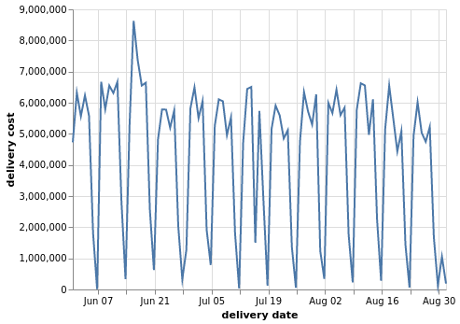
Cost vs date

Slide 23
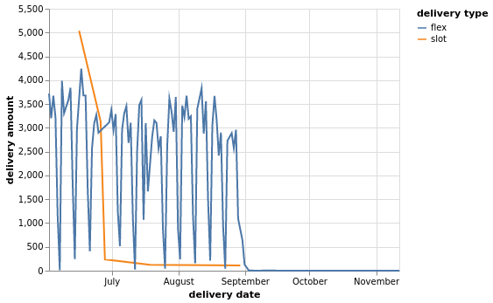
Delivery type amount vs date

Slide 24
Clustering (features analysis)
What are the common characteristics of the tasks with delay on delivery time?

Slide 25
Clustering (features analysis)

Slide 26
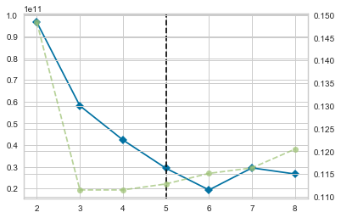
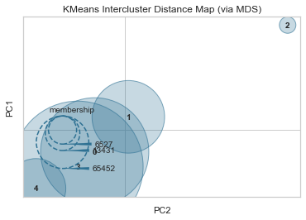
Clustering without standardization

Slide 27
Clustering without standardization

Slide 28
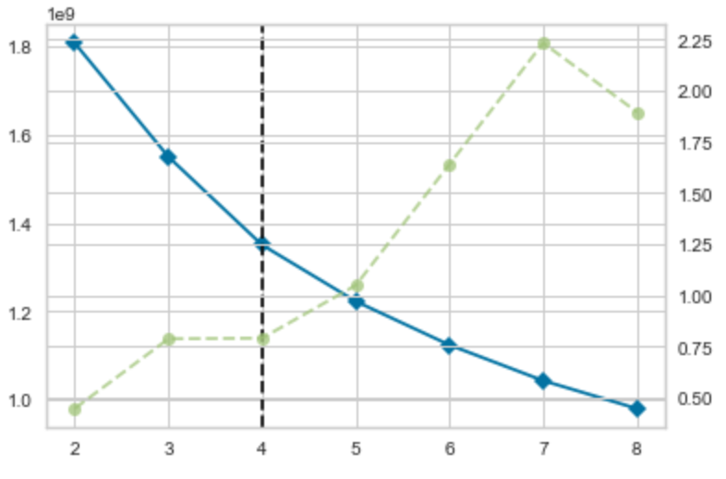
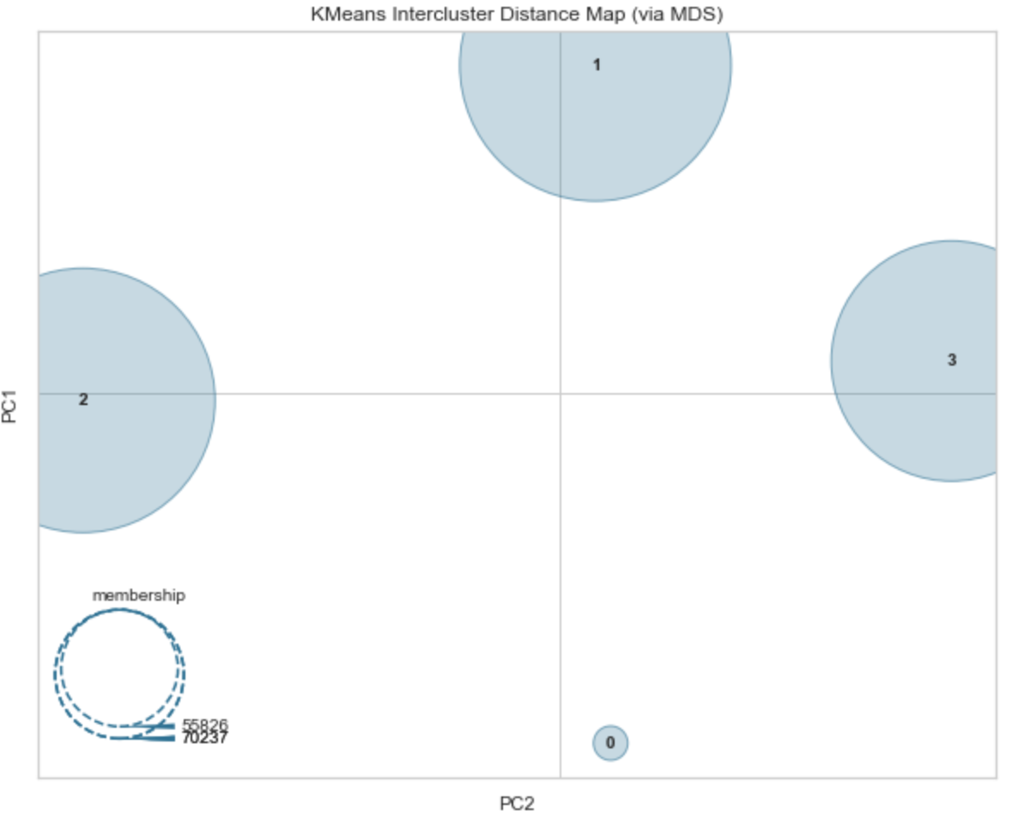
Clustering with standardization
Cluster | Population
Cluster 0 | 25518
Cluster 1 | 75247
Cluster 2 | 70237
Cluster 3 | 55826

Slide 29
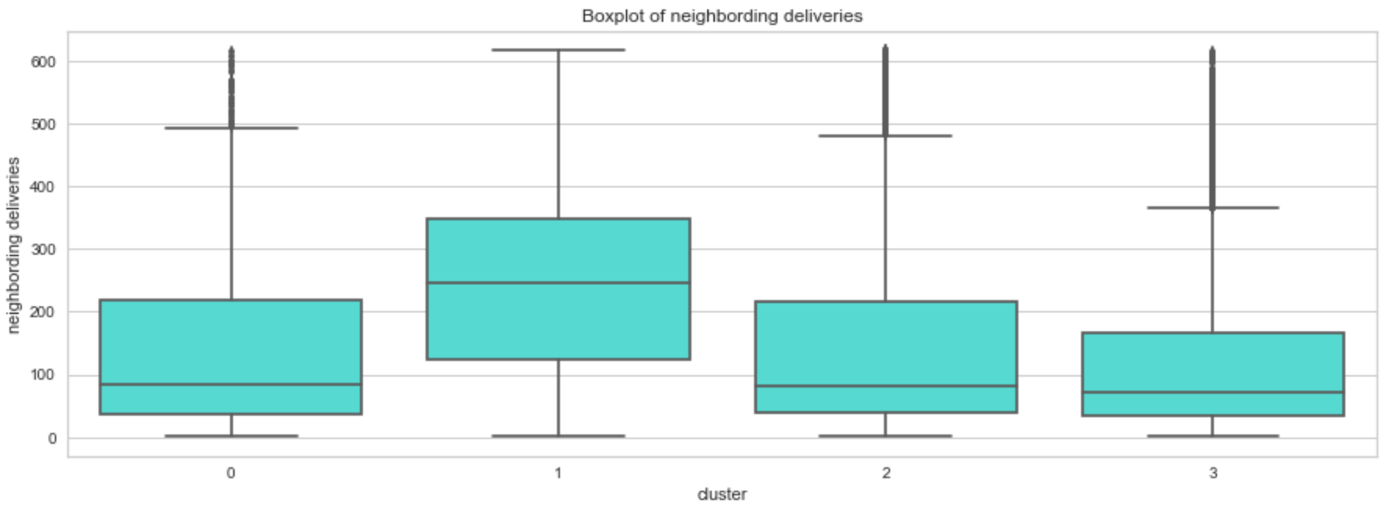
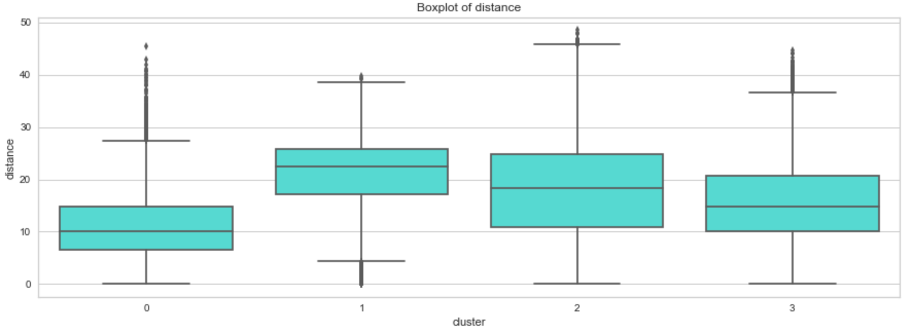
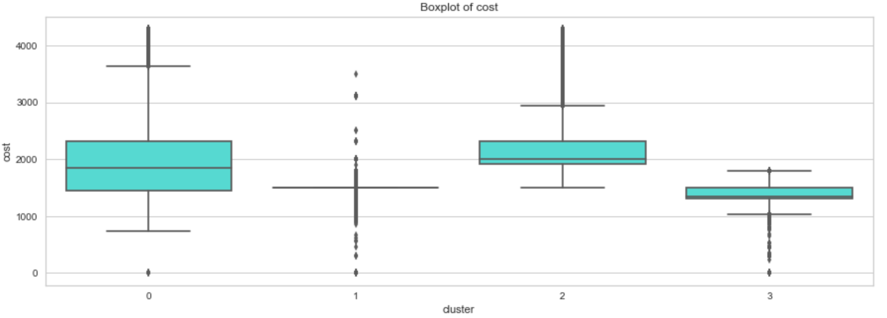
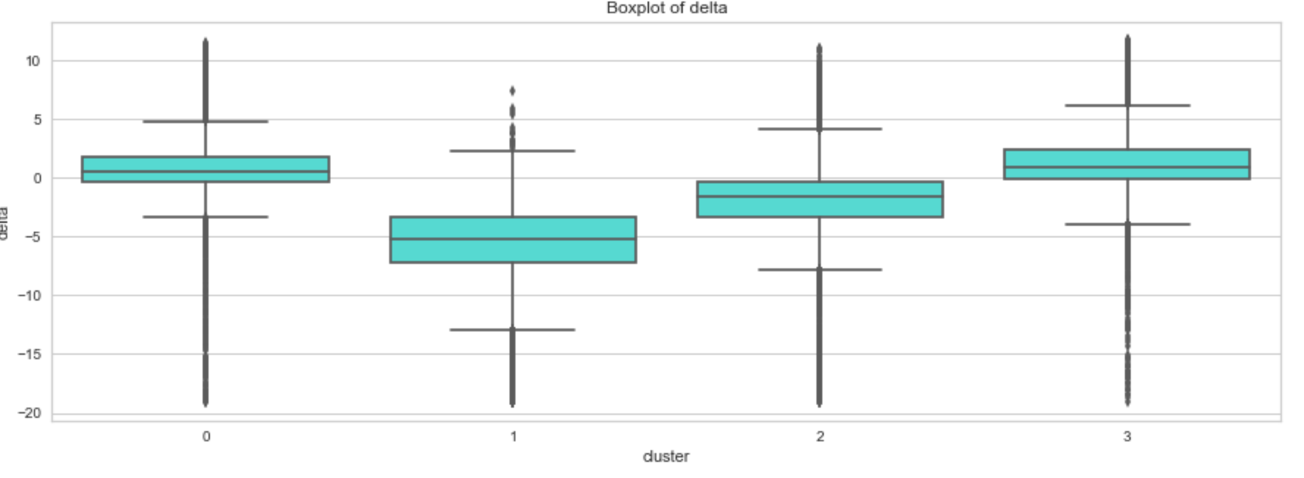
Clustering with standardization

Slide 30
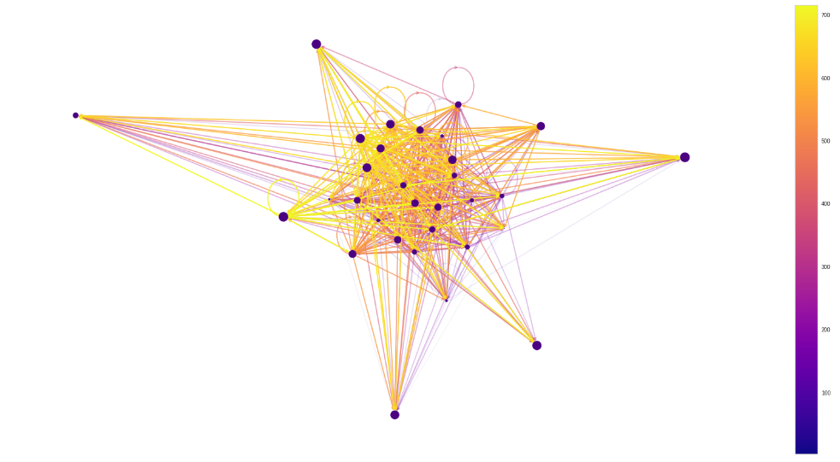
Social network analysis
Does the traffic intensity at the destination point of a delivery influence the delivery time?

Slide 31
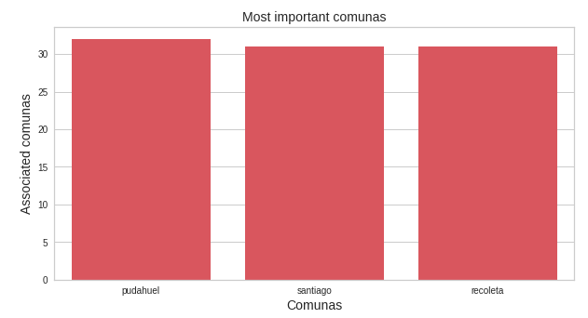
Important comunas: criteria A

Slide 32
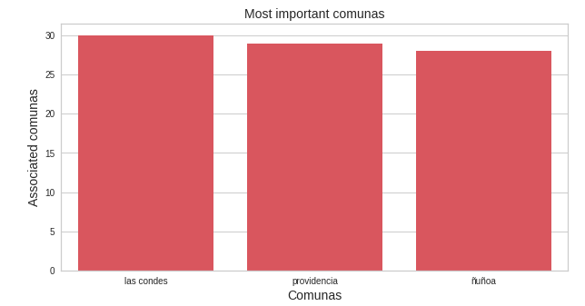
Important comunas: criteria B

Slide 33
Model Predicition
After creating metrics and analyzing the ones that correlate with the timeliness of deliveries, we defined a linear regression model with the following features to predict the delivery effective time:
Cost
Lat delivery
Long delivery
Task around
Distance
Total size
Delivery type
Pickup effective time
Delivery time

Slide 34
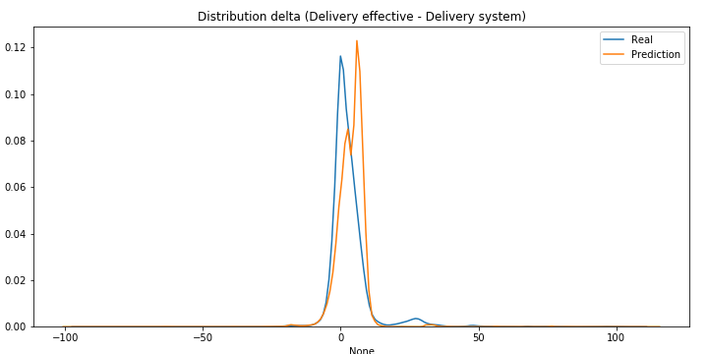
Model evaluation
MAE | 14562.92
RMSE | 60948.58
R2 score | 0.999300
F1 (Press) | 0.884001
F1 (Delta 1 hour) | 0.819623
F1 SLA D0 | 0.866670
F1 SLA D1 | 0.993673

